Slide 1
walkthrough horizontal prototype

Slide 2
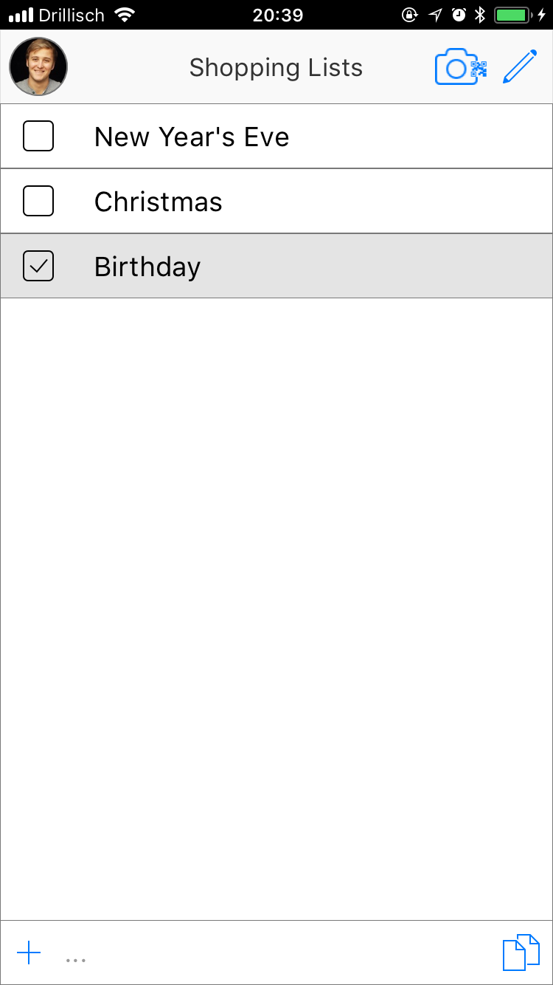
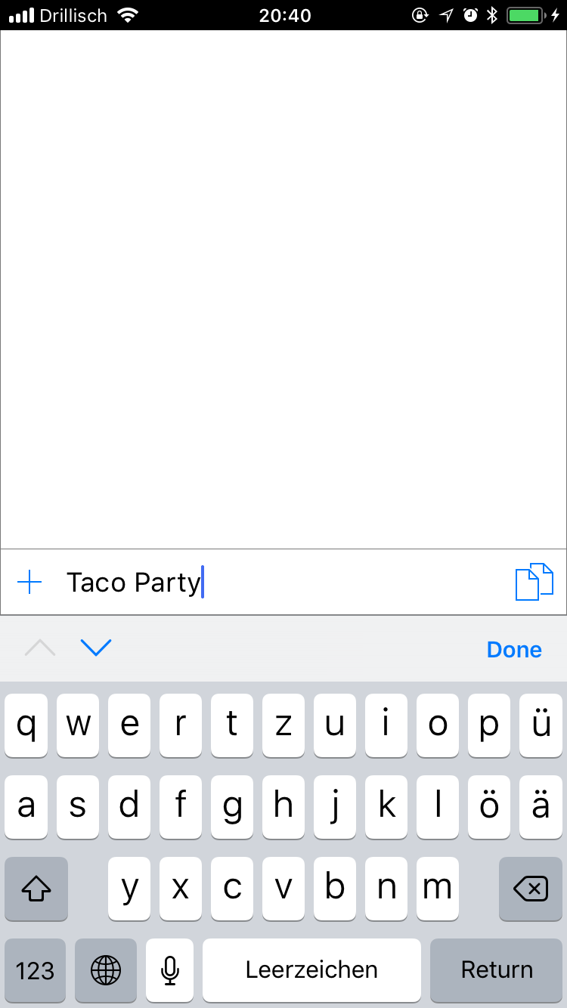
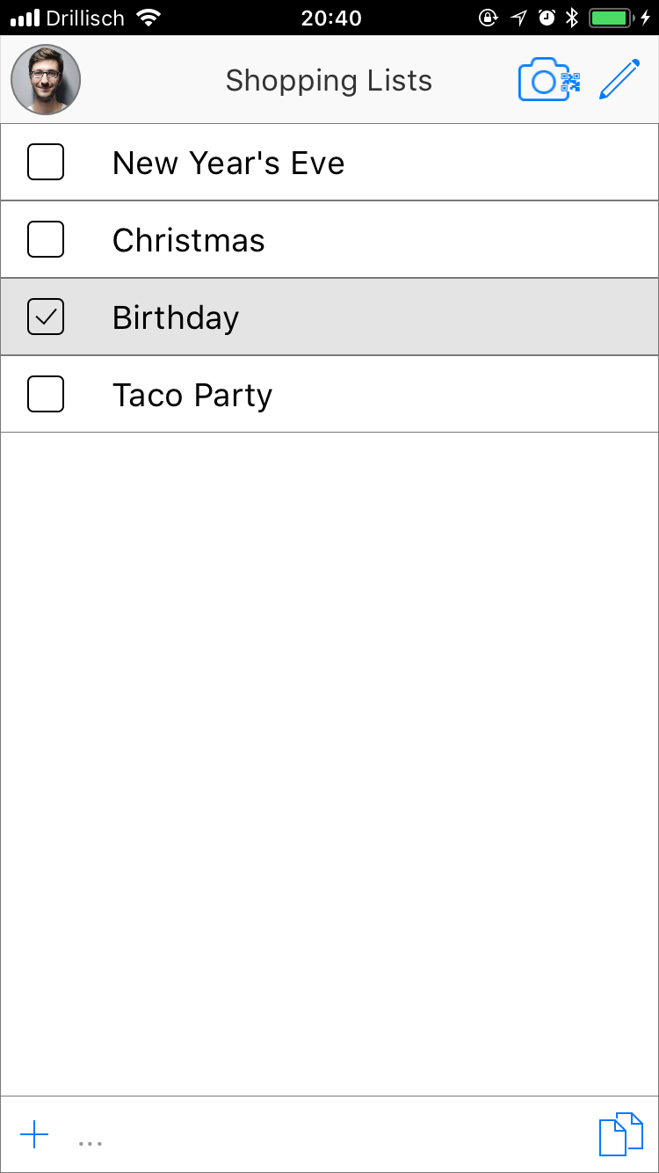
Home Screen with all existing shopping lists.
Add a list by hitting the „+“ Button at the bottom of the screen, type in the name and confirm with done.

Slide 3
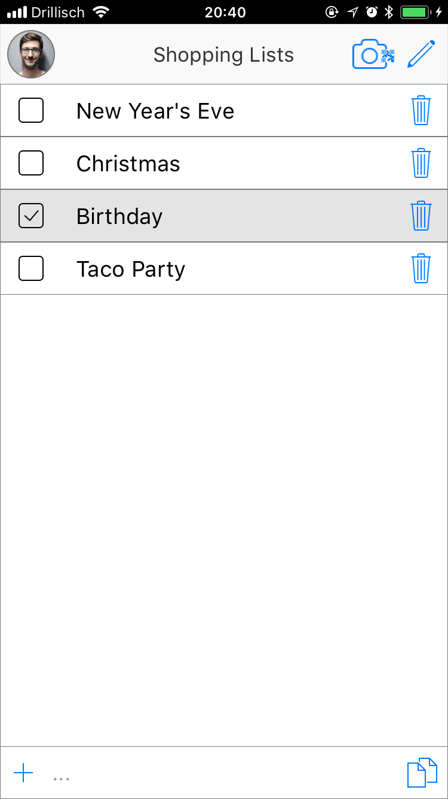
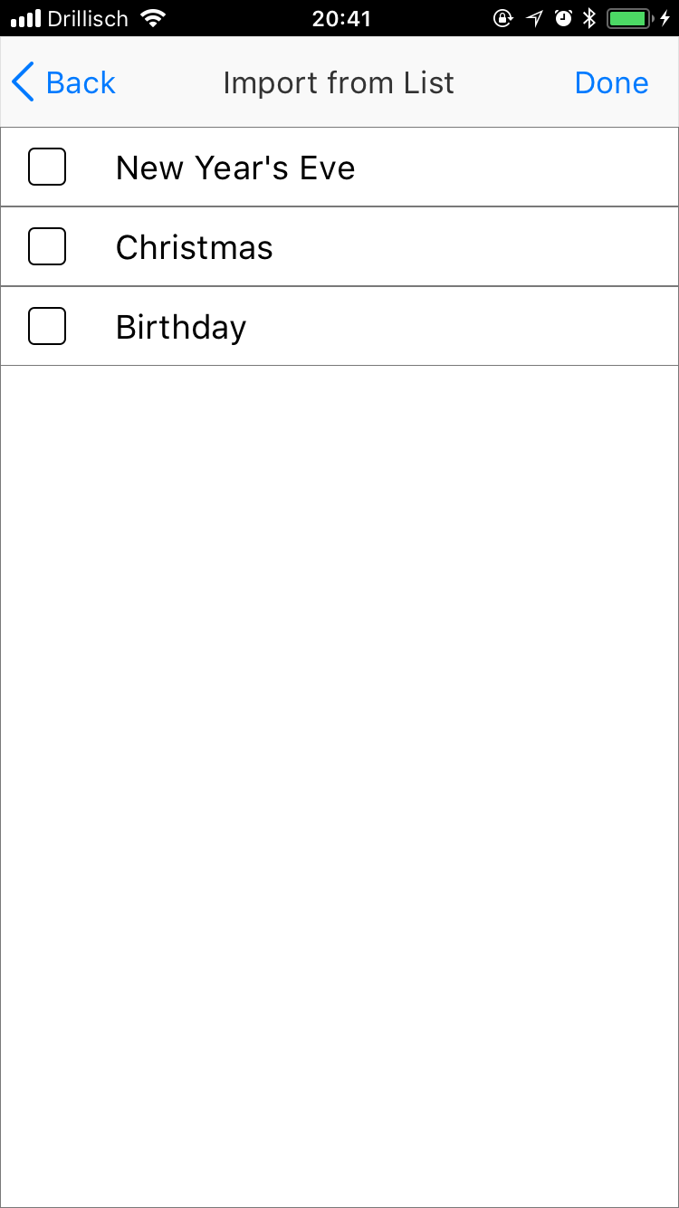
Delete lists by activating the edit mode (pen in the top of the screen) and hit the trash can symbol next to the list you want to delete.

Slide 4
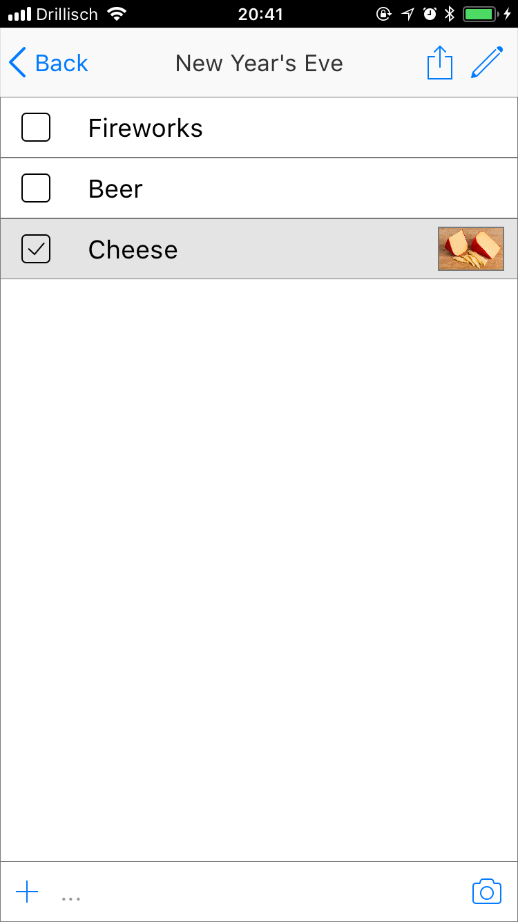
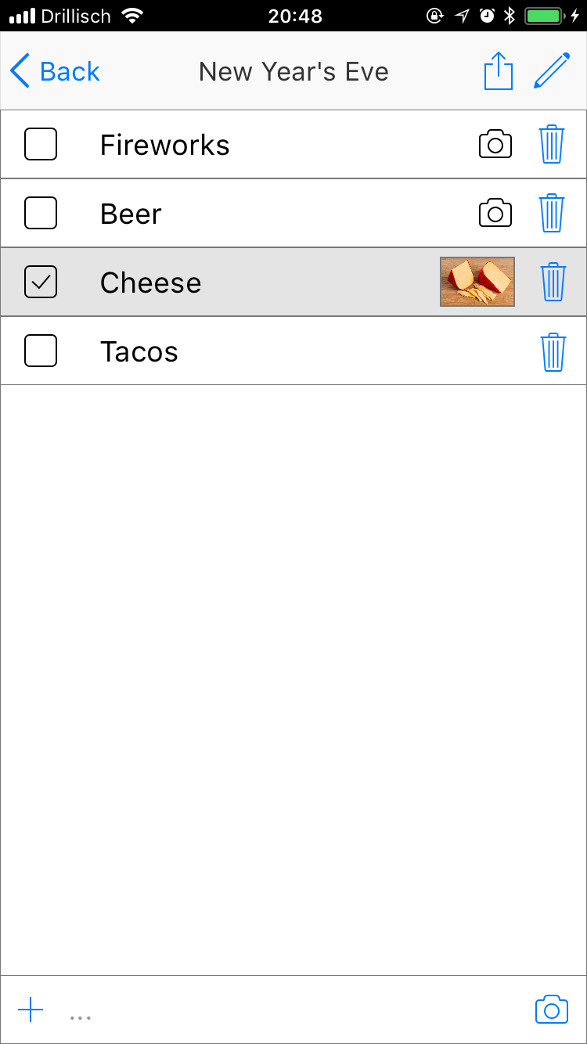
Open a list by pressing it. (Example is new Year‘s Eve)
Delete list items in edit mode with the trash cans like with lists before.

Slide 5

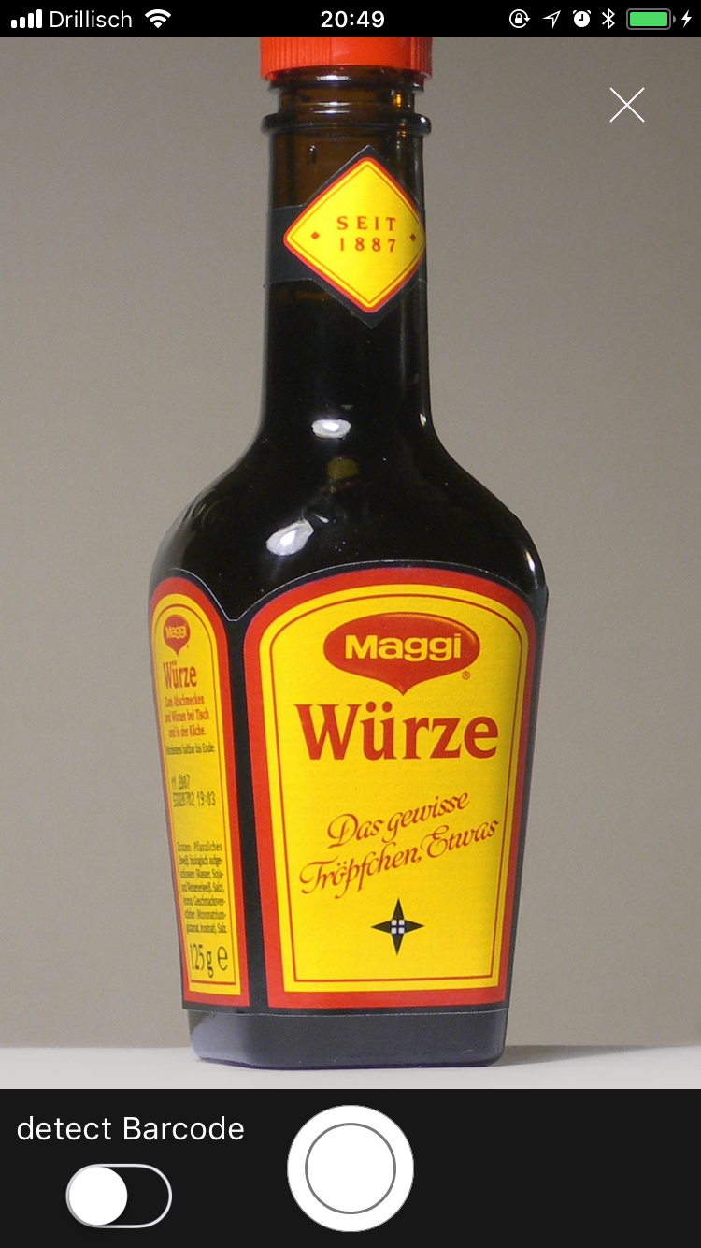
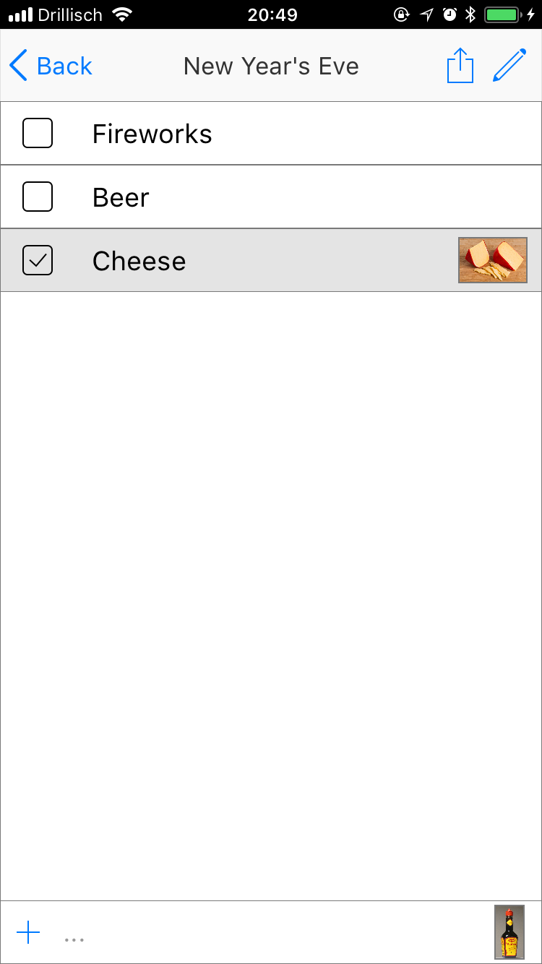
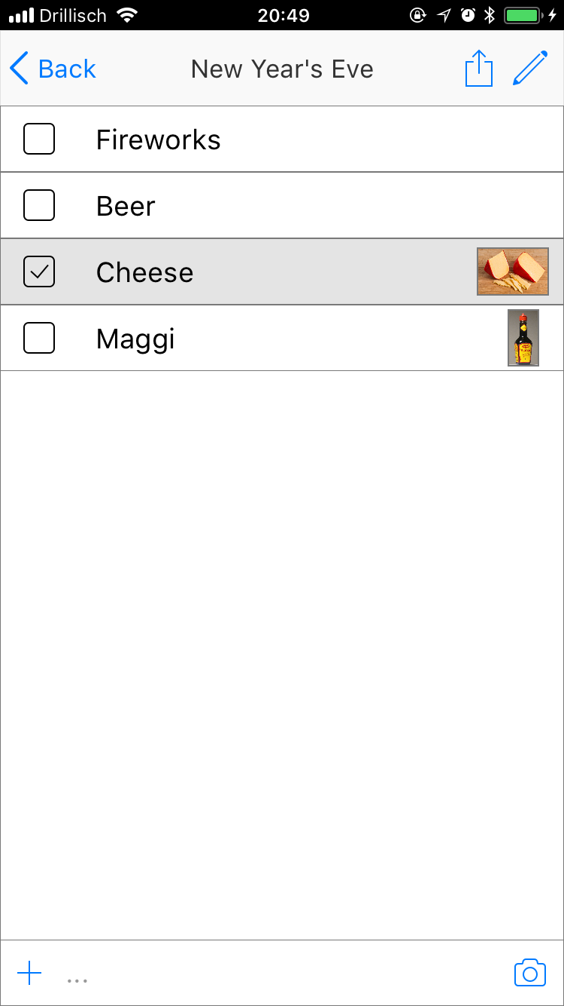
Add an item to the current list by hitting the „+“ button in the bottom and typing a name. You can also add a picture with the camera button.

